Slide 1
Korean Wave
October 12, 2017
Cha Young-cheol
Korean Consul General

Slide 2
Contents
∆ Brief Introduction on Korea
∆ Korean Wave
- current status
- reasons of popularity
- future
∆ Turkish Wave?
* remarks
- Korea refers to the Republic of Korea or South Korea
- the views based on literature, media report,
and personal observation on Korean Wave

Slide 3
∆ Brief Introduction on Korea
■ Size (South Korea): 99,678 km²
* Korean Peninsular: 223,098 km²
■ Population: 51.7 million
■ Cultural characteristics
- heavily influenced
▪ by Confucianism & Buddhism (past)
▪ by Western (American) Culture(50s-80s)
▪ mixed & new Culture (since the late
1980s)
- speedy culture + digital age: synergy effect

Slide 4
■ defensive history
- isolation policy (16c-19c)
- colonization (1910-1945)
- Korean War (1950-1953)
■ after Korean War
- democratization, industrialization
- external pressure by globalization, free and fair trade
→ liberalization, openness to foreign culture and
globalization/internationalization
* 22 million overseas trip per year,
2 million foreigners in Korea

Slide 5
■ major statistics
- Nominal GDP(USD): 12th in the world (IMF)
$1.3 billion (1953) → $1.49 trillion (2016)
- GNI per capita at purchasing power parity
(USD): $67 (1953)→ $ 29,000 (2016)
- 8th largest trading nation(2016):
USD 1 trillion
- high fever on education:
■ FTAs with world majors: US, EU, India, China,
ASEAN, Australia, New Zealand, Turkey etc.

Slide 6
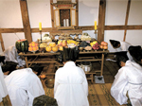
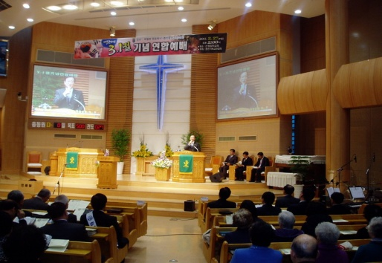
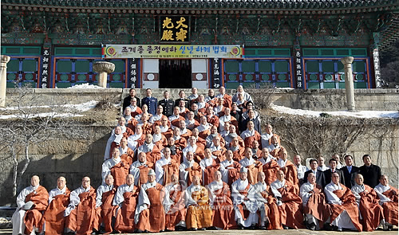
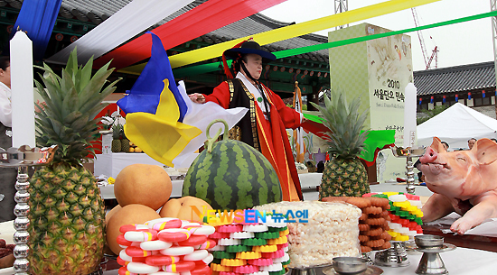
Religions of Korea
■ Christianity: 29.2%
- Catholic-10.9%, Protestant-18.3%
■ Buddhism:22.8% ■ Muslim: 200, 000
■ Others: Confucianism, Shamanism, etc.

Slide 7
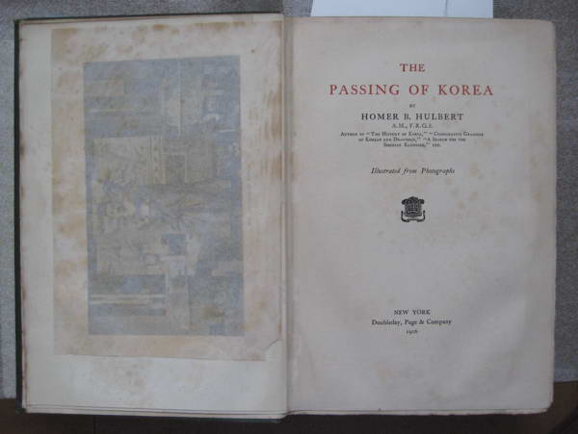
H.B.Hulbert(American Traveller)
“Korean will be a Confucianist when in society,
a Buddhist when he philosophises and
a spirit-worshipper when he is in trouble.”
† The Passing of Korea, 1906, New York

Slide 8
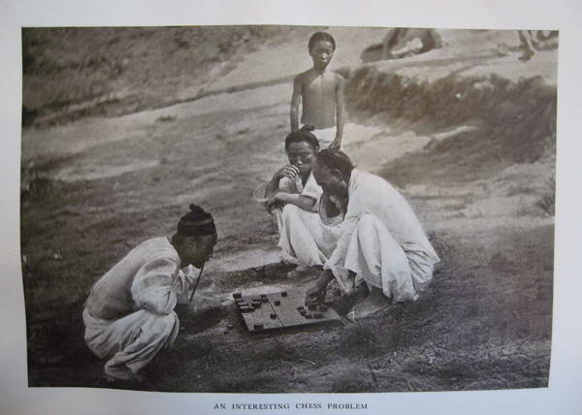
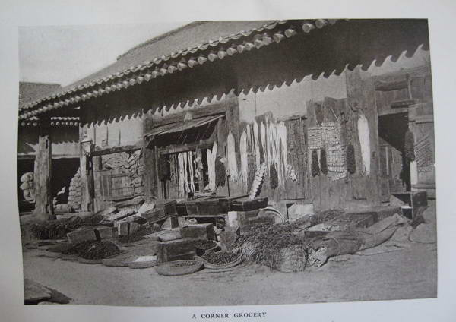
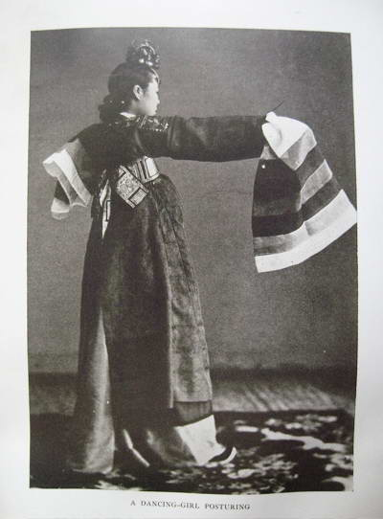
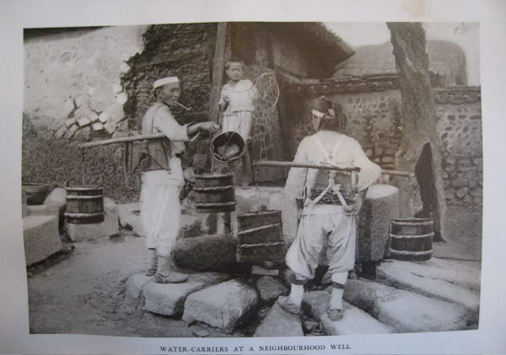
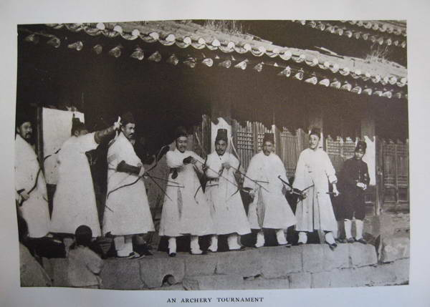
Koreans in 1905

Slide 9
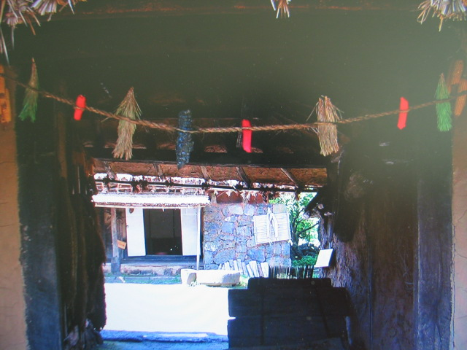
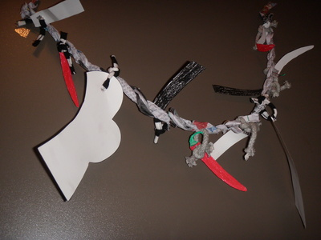
Korean Customs
■ Birth: straw rope to ward off evil spirits(21days)
- Boy: chilly, straw, charcoal
- Girl: seaweed, pine needles, papers, charcoal

Slide 10
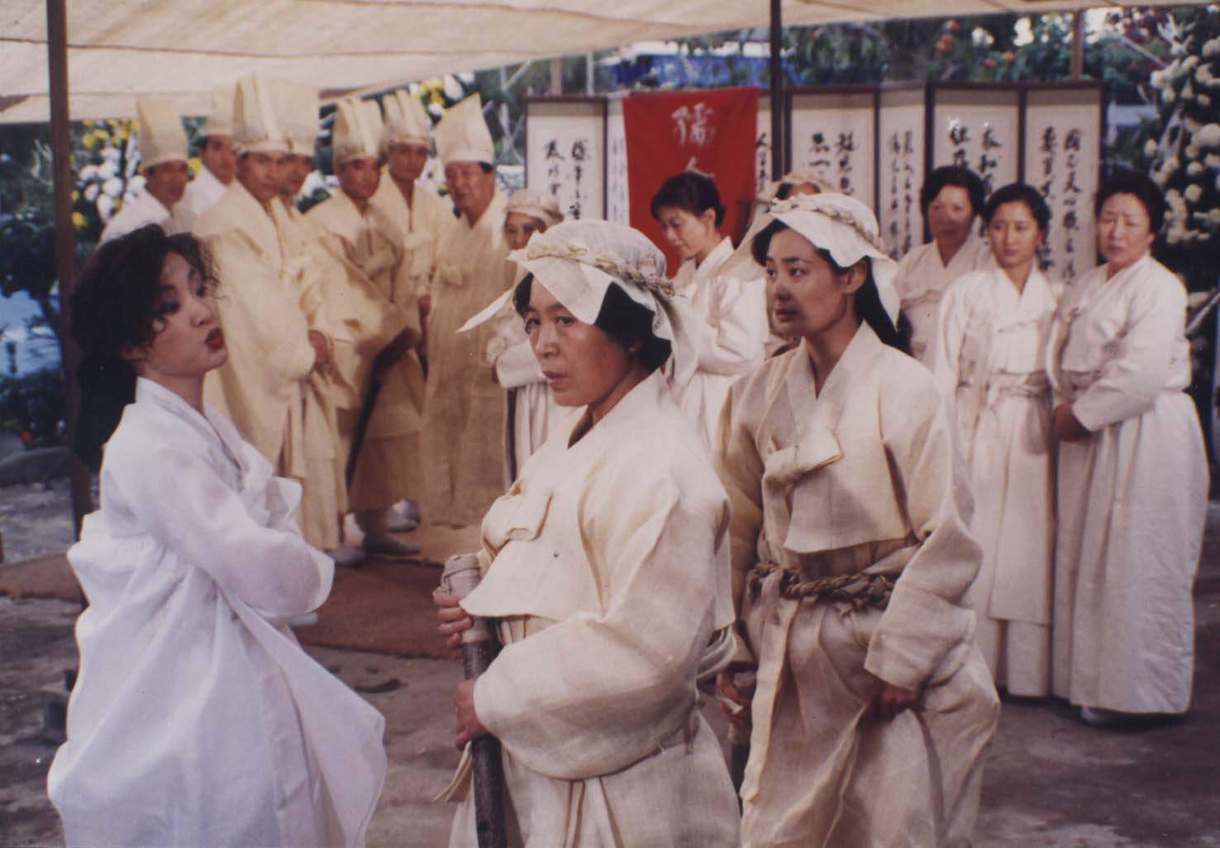
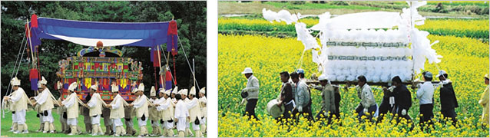
■ Funeral Ceremony

Slide 11
∆ Korean Wave (Hallyu)
■ What is Korean Wave?
- world-wide popularity of Korean Pop Culture
* Chinese Press coined the term in the late 90s
- four pillars
1. K-Films
2. K-TV Dramas
3. K-Pop (group dance + music): New Wave since 2010
4. Other Entertainment Products : online-game, animation,
cartoon, fashion, cosmetics, food, tourism, etc.
■ Base of Korean Wave: hybrid culture
- Western modernity + Asian sentimentality (K-Drama)
- an ongoing and evolving process in digital age,
interacting with other cultures (K-Pop)
- not pure Korean one, a new language spoken in a speedy,
global world (K-Pop)

Slide 12
International Media Coverage
■ Lara Farrar, CNN World, Dec. 31, 2010
“Over the past decade, South Korea has become the
Hollywood of the East, churning out entertainment that
is coveted by millions of fans stretching from Japan to
Indonesia.”
■ Steven Viney, Al-Masry Al-Youm, July 19, 2011
“Whether it’s through films, music, books or food, the ‘Korean
wave’ has definitely hit Cairo, and is doing so with much fervor.”
■ IHT, March 6, 2012
“Social media make it easier for K-pop bands to reach a wider
audience in the West”

Slide 13
■ Financial Times, Feb.10, 2012
“Just days after their first appearance on US network television with their hit single “The Boys”, the band of nine telegenic women this week returned to France – where tickets for a 2011 concert sold out in 15 minutes – to sing on prime time television. The Hallyu – or “Korean wave” as the phenomenon is known in Asia – is now spreading to Europe and the US, and spurring South Korea’s export earnings.”

Slide 14
Economic Value of Korean Wave
“ Cultural exports – including films, comics and computer games – causing the share prices of leading entertainment studios to soar. Even Korea’s favorite cartoon character, the penguin Pororo, has appeared on television in 120 countries.”
■ Direct export effect: USD 7 billion in 2015
■ Indirect effect: ca. USD 14 billion in 2015
- facilitate the export of Korean goods, attract
tourism to Korea, and increase
the employment
- USD 83 billion in 2020 expected
■ valuable Soft Power

Slide 15
Overview of Korean Entertainment Industry
■ dominance of imported music & films
- 1950s- the late 1980s
* local singers mimicked the tunes and
styles of foreign music in Korea
- American Forces Korea Network since 1957
■ appearance of mixed & new type of culture
since the late 1980s in Korea
■ growing of Korean films, TV dramas since mid-1990s,
and K-Pop in the late 1990s in domestic market
■ K-films, K-TV dramas exported to Southeast Asia
since the mid-1990s and beyond since 2000
■ K-Pop spread to global audience since 2010
- K-Pop attracted audience in Korea and Japan, China,
Hong Kong, Taiwan , and Europe, USA, Middle East
■ Booming of other entertainment industry

Slide 16
Positive Domestic Environment for Korean Wave
■ Democratization + Speedy economic development
■ Highly developed IT infrastructure
* high speed internet connection: 1st among OECD
■ Open-market policy, pro-globalization
- market liberalization measures
- competitive pop culture environment
■ Strategic approach by entertainment producers
■ Singing culture: Karaoke

Slide 17
1. Korean Film

Slide 18
Korean Film Industry
■ Movie market opening (1980s-1990s)
- global pressure of market opening
* domestic market share of K-films: 15.9% in 1993
■ Paradigm shift in 1994 in Korean society
* Jurassic Park Factor: USD 350 million only in 1993
“ total revenue of one film equaled to (based on net
profit) the sales of 1.5 million Hyundai cars abroad”
- conglomerates invested to movie industry
in recognition of the value of entertainment industry
■ Screen Quota abolition
- protection of domestic movie films
* domestic market share: over 50% since 2001

Slide 19
Contribution of conglomerates to film-
industry
■ a solid foundation for movie industry
■ new way for a capital mobilization for film production
- triggered venture capitals & investment firms to enter
the film industry
* in 2000, venture capitals funded 23 out of
58 Korean films
* average cost of a film production: USD 0.9 million
in 1995 → USD 42 million in 2004
■ introduction of advanced business knowhow,
planning & marketing skills
■ building of many, modern multiplex theaters
- facilitated film consumption nationwide
* 497 in 1997→ 1,132 in 2003 in Korea

Slide 20
Birth of Korean Blockbusters
■ Shiri: 6 million viewers in 1999
- beating out Hollywood box office hits like Titanic,
the Matrix, and Star Wars in Korea
■ Joint Security Area: 8 million in 2001
■ Silmido: 11 million in 2004
■ Taegukgi: 11.7 million in 2004
■ King and the Crown: 12 million in 2006
■ K-film export: USD 55 mil(2015)
■ many Korean directors, actors awarded
at Int’l Film Festival

Slide 21
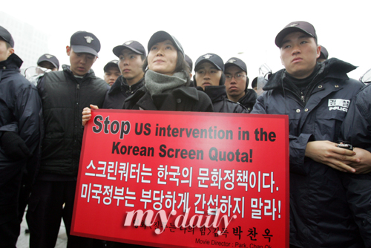
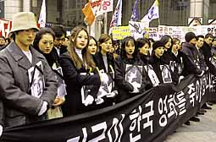
Screen Quota negotiation with U.S.
■ US film export to Korea decreased since 1999
■ reduction of showing period of domestic films at Korean
cinema: 146→ 73 days in a year in 2006
- removal of protection shield
* violent demonstration by even actors
■ since 2008, movie industry got stronger in Korea
without legal protection

Slide 22
Korean Film Export
 | 95 | 97 | 99 | 01 | 03 | 05 | 06 | 07 | 08 | 15
Total revenue mill.$ | 0.2 | 0.5 | 5.9 | 11 | 31 | 76 | 24 | 24 | 20 | 55
No. of films | 15 | 36 | 75 | 102 | 164 | 202 | 207 | 321 | 361 | 650
Price/film 1,000$ | 14 | 13.6 | 79 | 110 | 188 | 376 | 118 | 38 | 57

Slide 23




Slide 24
2. Korean Drama

Slide 25
Growth of Korean TV Dramas
■ “Drama War” in Korea
- centerpiece of TV watching
- in 1995, cable TV services → intense competition
- enhanced quality, over 30% share of audience ratings
■ K-TV Drama export since the mid-1990s
- unintended success under economic crisis in 1997-1998
- weakening of popularity of Japanese TV Dramas in Asia
- most Asian countries opened their TV program markets
■ Introduction of new system in Korea
- in 2005, digital multimedia broadcasting in Korea
- in 2006, Internet Protocol TV in Korea

Slide 26
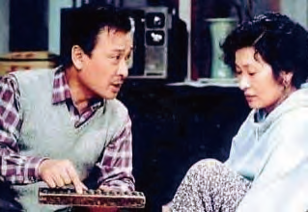
Korean Wave in China
■ in 1997, CCTV broadcast “What is Love all about”
* over16% audience share, on audience-demand
rebroadcast in 1998
* story: the tensions and harmony
of a couple from two very
different families, one
liberally minded and one
conservatively minded

Slide 27
Korean Wave in Southeast Asia
■ Vietnam
- in 1998, in Vietnam K-TV drama accounted
for 56% of all imported TV programs
- current K- TV drama share in Vietnam TV program: 30%
- prime time share of K-TV drama: 60%
■ Singapore
- after “ Dae Jang Geum” (Jewel in the Palace) was
rebroadcast for the fourth time in Singapore,
the number of Korean restaurants in the city
mushroomed from ten to sixty.

Slide 28
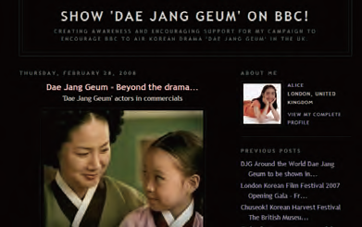
K-TV Drama beyond Asia
■ “Dae Jang Geum”(Jewel in the Palace)
→ a “Dae Jang Geum Fever”
- aired in more than 60 countries
* story: the ups and downs
of an orphaned girl who
became the king’s chief
physician
* in Iran, it recorded truly impressive ratings of 86%
nationwide, and more than 90% in the capital of Tehran.
* Previous Chinese President Hu Jintao was known as a fan of
“ Dae Jang Geum”

Slide 29
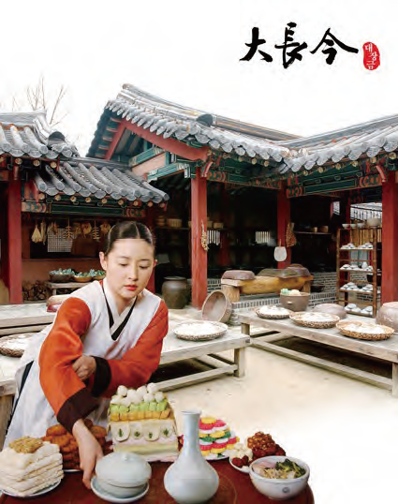

Slide 30

“Winter Sonata in Japan”
■ peak of Korean Wave in Japan in 2003
- NHK TV ran “Winter Sonata”
- caused an unprecedented cultural phenomenon
- surprising response from middle-aged Japanese
women
* for its fourth run in 2005, NHK
ran it in original Korean with
Japanese subtitles to preserve the
original atmosphere of the show

Slide 31
“Yon-sama” Syndrome in Japan
■ in 2004, 5,000 Japanese women flooded Tokyo’s
Haneda Airport
■ when one episode of Winter Sonata canceled for
a TV special on the Japanese prime minister’s
visit to North Korea, NHK was inundated with over
3,000 phone calls
■ reason for syndrome
- the drama reminds them of good old days
when they cherished pure love

Slide 32
Norimitsu Onishi, The New York Times Dec. 23, 2004
“Fads come and go in Japan, but this one touches upon several deep issues in Japanese society and its relationship with South Korea. Yon-sama seems to touch upon the Japanese nostalgia for an imagined past, and upon middle-aged women’s yearning for an emotional connection that they lack and perhaps believe they cannot find in Japan.”

Slide 33
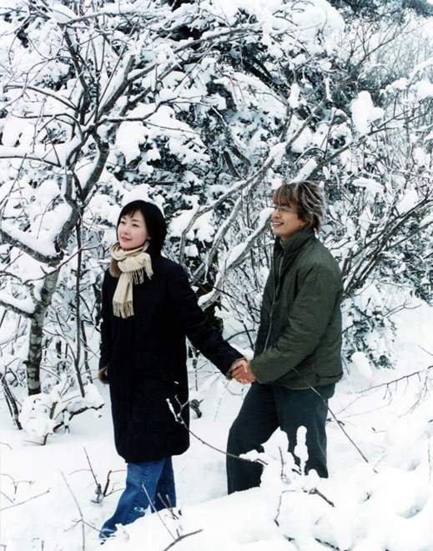




Slide 34
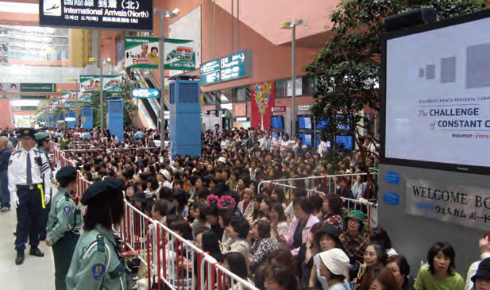
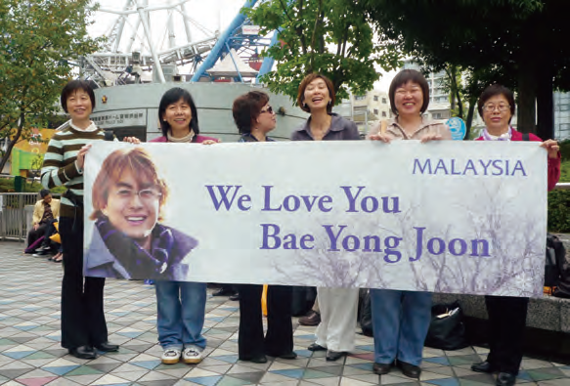

Slide 35
Characteristics of K-Drama
■ emphasis on emotion in human relations
- drawing more women viewers
■ dramatization of Asian values
- balance between modernism & traditionalism
- Asian cultural affinity
- embracing cross-generational viewers
* Asian values: respect to family and mutual
support in family/community, polite, care,
cultural diversity, tolerance etc.

Slide 36
Export and Import of TV Programs
(Unit: US$1,000)
 | 2000 | 2001 | 2002 | 2003 | 2004 | 2005 | 2006 | 2007
export | 13,000 | 20,000 | 30,000 | 44,000 | 78,000 | 125,000 | 140,000 | 162,580
import | 29,000 | 25,000 | 28,000 | 33,000 | 35,000 | 40,000 | 35,000 | 32,260
 | 2008 | 2009 | 2015
export | 180,168 | 183,580 | 320,434
import | 21,847 | 65,948 | 146,297

Slide 37
3. K-Pop (group dance + music)
- New Wave since 2010

Slide 38
K-Pop, New Korean Wave
■ global K-Pop fever since 2010
- idol” groups, causing a completely new trend,
expanding the borders beyond Asia to global audience
■ main spreading tools
- Social Media: You Tube, Twitter, Facebook, Blogs
■ main audience: mostly young women
* K-Drama: mainly 30-40 women
■ watch, hear + proactive participate
- “Cover Dance”
- fans imitate the dances of favorite K-pop singers
* the 1st International 2011 Cover Dance Festival,
over 16 million views for the first round of competition

Slide 39
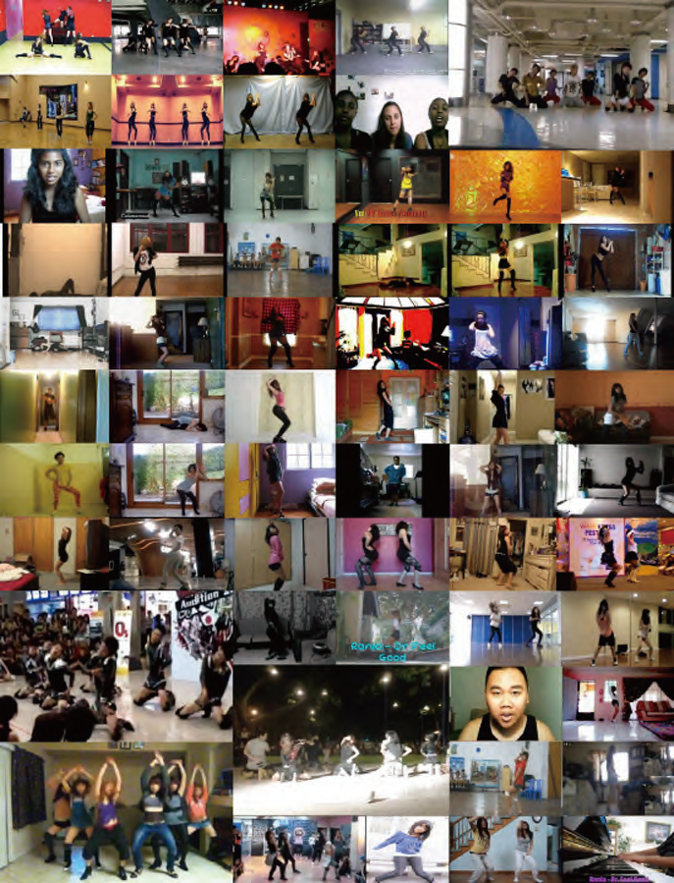

Slide 40

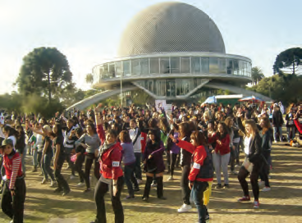
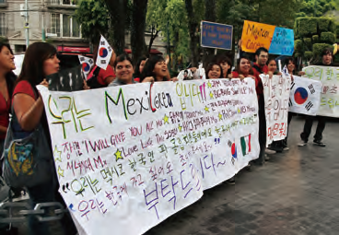
New Wave: Around the World

Slide 41
New cultural Phenomena
■ You Tube videos 2.3 billion times hit in 2011
■ video of Girls’ Generation”, Gee,” 60 million times hit
a live YouTube broadcast of Big Bang,
watched simultaneously by 390,000 people worldwide
■ Paris in November 2011,
7,000 seats sold out in just 15 minutes
■ the biggest English-language websites on K-pop
such as Allkpop.com generate more traffic than
major Korean music portal sites
■ K-Pop World Festival Competition in Korea
- 15 teams chosen from 72 countries(2017.9.29)

Slide 42
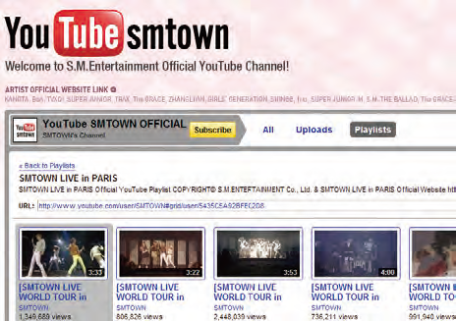
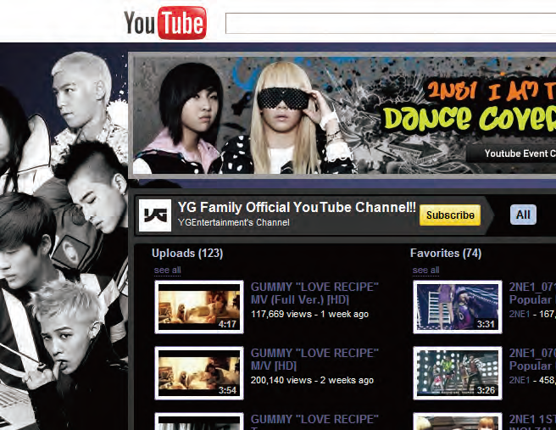

Slide 43
■ by Continent (unit: million times): 2010
566.27-Asia, 123.47 -North America, 55.37-Europe,
20.5-South America, 15.1-Middle East,
10.7-Oceania, 1.9- Africa
■ by Nation(unit: million times): 2010
Japan-113.54, Thailand-99.51, South Korea-57.3,
Philippines-38.9, Vietnam-5.6, Australia-9.4,
US- 94.87, Canada-20.9, Russia-1.28, UK-8.28,
Germany- 5.59 , Brazil-6, Saudi Arabia-10.3,
Egypt-0.63, Kuwait- o. 41, Montenegro- 22,000 hits,
New Caledonia-14,000 hits, North Korea:224 hits

Slide 44
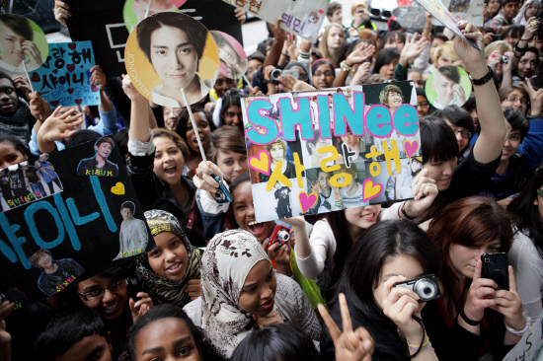
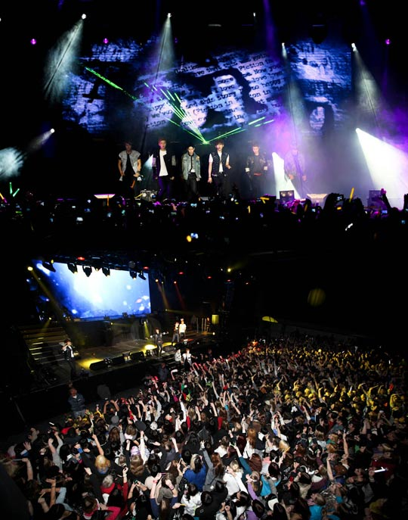
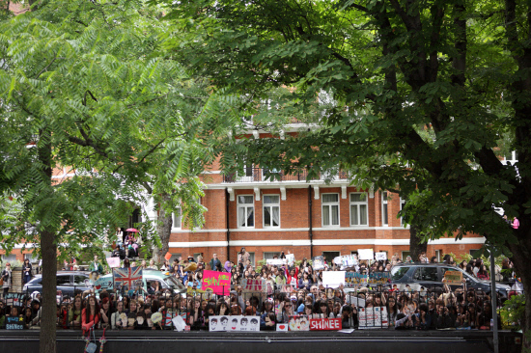

Slide 45
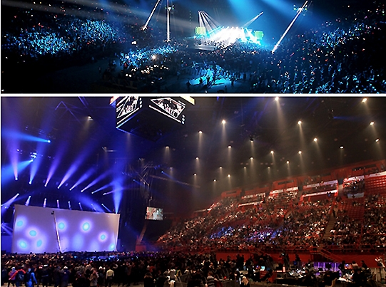

Slide 46
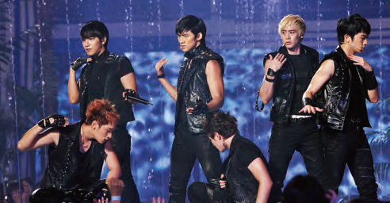
2PM is a six-member boy band. 2PM is one of the two subgroups branched out from the eleven member boy band One Day, the other being 2AM. In 2009, it was named Best Male Group and Artist of the Year at the M.net Asian Music Awards.
2PM

Slide 47

The world got to watch the formation of this boy band in 2006 through the TV series Big Bang Documentary. The group has gone on to commercial success, releasing several successful albums and singles. Time magazine described them as one of the “most promising” South Korean acts to venture into Japan.
Big Bang

Slide 48
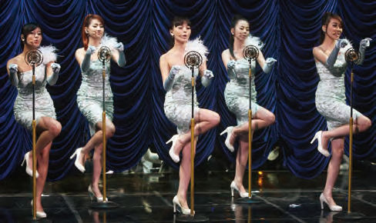
Debuting in 2007, the Wonder Girls set the music scene on fire with their hit song “Tell Me.” It was the first of four consecutive No. 1 singles. The group also found success in the American market in 2009 with an English version of their hit single “Nobody,” which made the Wonder Girls the first Korean group to break into Billbaord’s Hot 100.
Wonder Girls

Slide 49
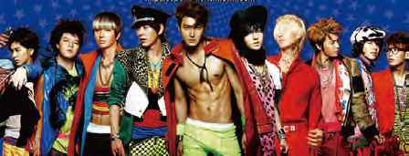
Super Junior
As one of Korea’s most popular boy bands, formed in 2005, in addition to their singing skills, Super Junior’s members possess many other talents as MCs, actors and DJs. They also divide into various smaller units based on various concepts and styles, such as Super Junior-M, which is aimed at Chinese-speaking fans. The group has released over 20 records. Super Junior is popular in Asia, Europe, the United States, South America and the Middle East, making them one of the key players in the global spread of the Korean Wave.

Slide 50
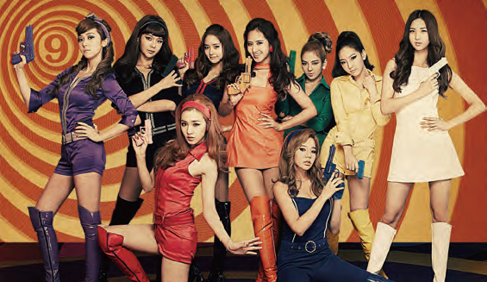
Formed in 2007, “Girls’ Generation “is a nine-member girl band. They broke into the Japanese market in 2010 with Japanese remakes of their 2009 hits “Tell Me Your Wish (Genie)” and “Gee”. The sensation Girls’ Generation caused in Japan was echoed by success not only cross the rest of Asia, but as far as Europe and the United States
Girls’ Generation

Slide 51

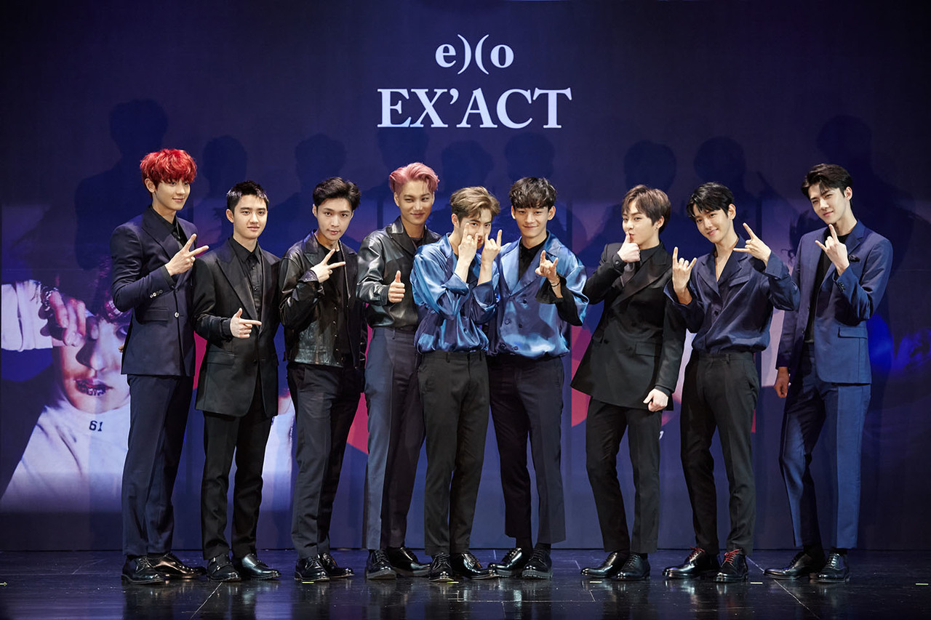
방탄소년단 BTS
엑소 EXO

Slide 52
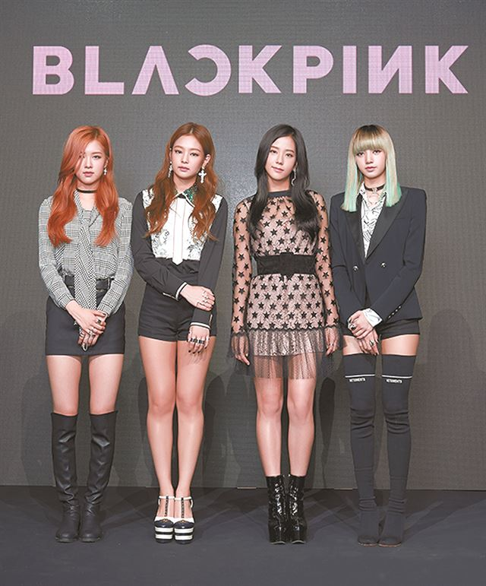

트와이스 TWICE
블랙핑크 Blackpink

Slide 53
Why K-Pop’s sudden global popularity?
* Poll survey: cheerful melody, dynamic group dances and good
looks of the singers
■ Characteristics
- blending: appealing melodies+ video arts+ strong beats
- short, catchy riffs that are repeated throughout the song
- Western pop style + slow Asian melody= new hybrid
■ Efforts of Producers
- improving sound quality, catching global music trend,
recruiting globally renowned songwriters and talented youths
from Korea and abroad
- systematic production: casting→ training→ producing→
global promotion

Slide 54
■ Go Digital: You Tube, Twitter, Facebook, Blog, etc.
- easy, cheap access
- appealing to “ Millennium Generation “
* generation of “Digital Grown Ups” capable of doing
multitasking, equipped with social media
■ Korean culture
- speedy social culture + Korean ICT infra
- cultural tradition: music/dance loving people
■ Fashionable outfits of Korean singers
■ Korean Society: active pursuance of internationalization
& globalization
- export-oriented economic policy
- open-market, liberalization policy

Slide 55
4. Other Entertainment Products

Slide 56

Game, Animation, Cartoon, others
■ Korean Online Game: export in 2016, USD 2 billion
■ Korean Animation: growing trend, exports
* Poporo the little Penguin, BOLTS & BLIP: 100 countries
■ Korean Cartoon export: $ 26 mil.(2014)
† a American film “The Priest”,
based on story of a Korean cartoon
earning USD 66.4 million
by the end of the first month
of its release in May 2011
■ Fashion, Food, Tourism etc.
■ Cosmetics

Slide 57



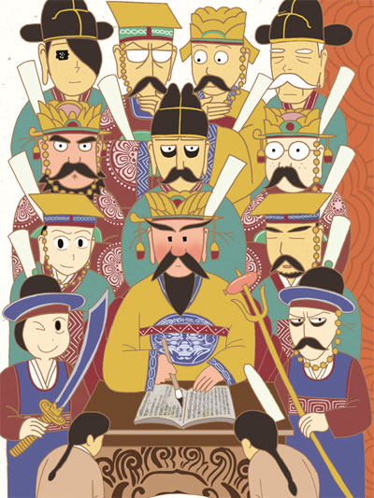



Slide 58


Slide 59
Future of Korean Wave
■ Negative Comments
- nothing more than a passing fad
* the Japanese pop culture boom of the 1990s
- excessively mechanical nature and
commercialization of Korean pop culture
- repetition of similar subject matters (K-drama)
- government’s support
- Anti-Korean Wave

Slide 60
■ Positive Comments
- a model of rapid modernization
while retaining its traditional color
- Korean development model
at work in the pop culture sector
- easy-to-follow tunes, dance moves, and storylines
- product of many years of hard work, planning,
and investment

Slide 61
■ Meaning of K-Wave in a globalized world
- cultural exchange and interaction is no longer
a one-way street
- also, Korea Wave is not simply Korean.
- It is an evolving process, mixing other culture very
fast, allowing diverse cultures to converge and
communicate each other.
- K-Pop provided an alternative to the
contemporary Western pop culture and contributed
to deeper understanding of globalization.
- global audience showed strong interest to a cultural
product from Asia, and provided a possibility that
other form of global public goods from Asia can
spread to the rest of the World

Slide 62
■ Future, the Next?→ Beginning of Asian Wave?
- One Expression of the Rise of Asia
▪ beyond economic powerhouse of the world
- China Wave? Turkish Wave?
▪ in areas, based on Asian values: philosophy,
arts, literature, diverse culture, new form of
regional and global governance, calm way of
life in a hectic world, assistance model, etc.
* a new economic development model based
on ancient Asian thoughts [Jørgen Møller,
“How Asia can Shape the World?]
* global public goods from East
[Kishore Mahbubani, “Can Asians Think?”]

